Slide 1
Web Portal Electronic Transactions Overview
Conduent
Government Healthcare Solutions

Slide 2
Purpose
The purpose of the web portal transaction overview is to familiarize providers with the electronic features available on the NM Medicaid web portal.

Slide 3
Objectives
We will review the following:
Provider Information
FAQs
Electronic Submissions Through the Web Portal
Web Registration
Provider Enrollment

Slide 4
Introduction of HIPAA
The Health Insurance Portability and Accountability Act of 1996, known as HIPAA, was enacted on August 21, 1996, as an attempt to incrementally reform the healthcare system. The goal was to simplify and streamline the burdens of healthcare. The most widely known portion of the law is the Administrative Simplification Section which includes requirements for the following:
Standardization of electronic patient health, administrative and financial data
Privacy
Security standards protecting the confidentiality and integrity of individually identifiable providers
Unique health identifiers for individuals, employers, health plans and health care providers

Slide 5
Why Utilize Electronic Transactions?
The push for administrative simplification originated in the health insurance industry as a way to standardize the claims processing and payment cycle, the eligibility and enrollment cycle, and even health insurers’ billing.
It is important to note that HIPAA does not require physicians to conduct transactions electronically. However, if they conduct any electronic transactions, they must submit these transactions according to HIPAA standards.

Slide 6
Billing Electronically through EDI
For questions regarding billing via Electronic Data Interchange, please reference the HIPAA 5010 Transactions Overview PowerPoint which is located on the NM Medicaid portal in the Provider Information section. It can be found on the following link:
https://nmmedicaid.portal.conduent.com/static/ProviderInformation.htm#TrainingPresentations

Slide 7
Provider Information

Slide 8
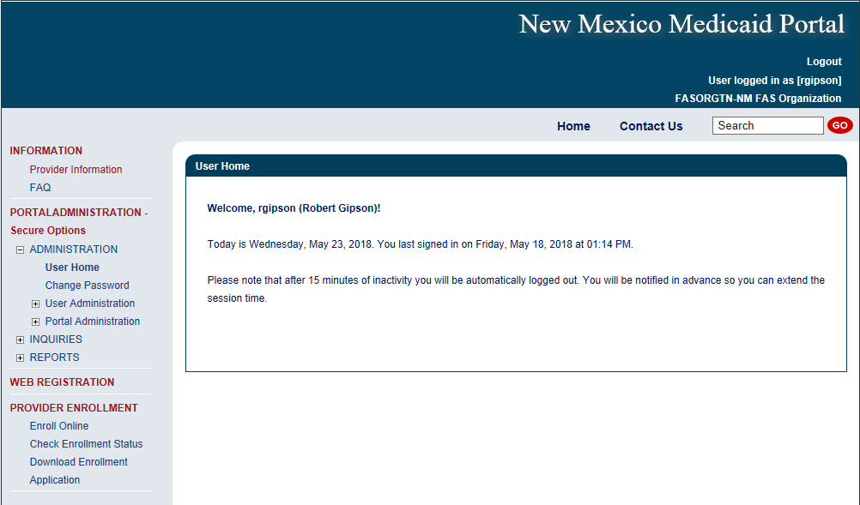
Provider Information & FAQs
Select Provider Information here

Slide 9
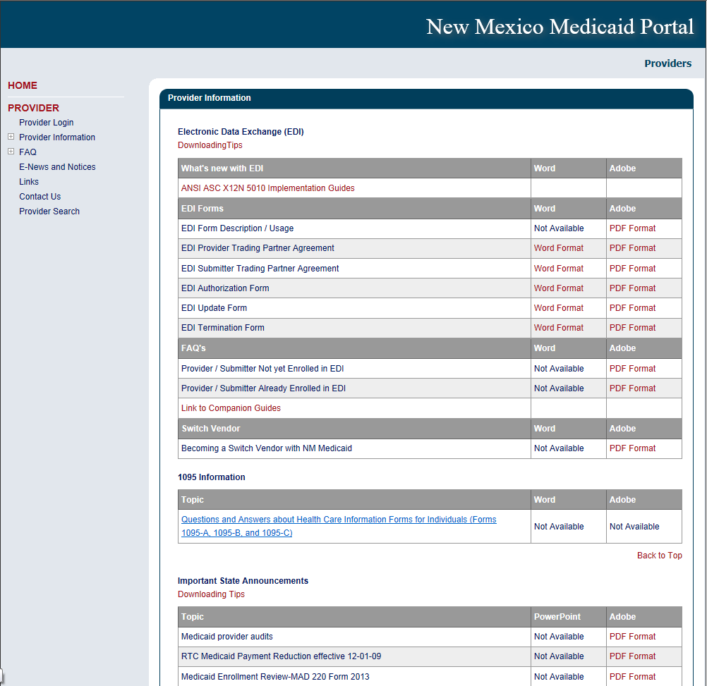
Provider Information
The Provider Information section is a resource for providers who are already enrolled as participating or looking to become NM Medicaid providers. https://nmmedicaid.portal.conduent.com/static/ProviderInformation.htm#sandbox_title

Slide 10
FAQs

Slide 11
FAQs
Select FAQ here

Slide 12
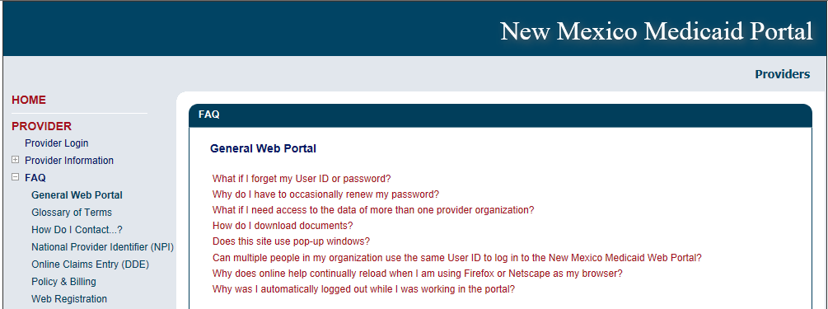
FAQs
The FAQ section poses general web portal questions that providers might encounter when trying to navigate the NM Medicaid web portal. https://nmmedicaid.portal.conduent.com/static/FAQ.htm

Slide 13
FAQs
What if I forget my User ID or password?
Contact your Master Administrator, click on the “I forgot my Password” link, or contact the HIPAA Help Desk at (800) 299-7304.
Why do I have to occasionally review my password?
For security reasons, your password expires every sixty (60) days. You will receive prompts to change your password five (5) days prior to its expiration.
What if I need to access the data of more than one provider organization?
Since your user ID can be associated with multiple organizations, the Master Administrator of each organization will have to associate your user ID with each organization.

Slide 14
FAQs (continued)
How do I download documents?
Move the mouse cursor over the name of the document and press right mouse key. Choose “Save Target As” or “Save Link As” and save to your PC.
Does this site use pop-up windows?
Yes, the inactivity warning message is a pop-up window. You should disable all pop-up blockers for this site only. If you do not, after 15 minutes of inactivity, you will be automatically logged out of the site without receiving a warning.
Can multiple people in my organization use the same User ID to log in to the NM Medicaid Portal?
No, each user should have his/her own unique User ID since there can only be one active portal session per User ID.

Slide 15
FAQs (continued)
Why does online help continually reload when I am using Firefox or Netscape as my browser?
This is a known issue with the third-party software used to author the portal's online help. The only workaround is to use a different browser program, such as Internet Explorer.
Why was I automatically logged out while I was working in the portal?
If you are inactive for 10 minutes and receive the Session Timeout Warning pop-up but continue working without clicking the 'Continue Working' button, you will be automatically logged out 5 minutes after receiving the warning. To avoid this, please be sure to click the 'Continue Working' button when you receive the warning message.

Slide 16
Electronic Submissions Through the Web Portal

Slide 17
NM Medicaid Web Portal
By creating an account and logging in to the New Mexico Medicaid Web Portal, users can do the following:
Submit CMS-1500, UB-04, and ADA Dental Claims.
Adjust claims (originally submitted via the Web Portal) that have paid and need to be corrected.
Void a claim (originally submitted via the Web Portal) that has paid.
Rebill a claim (originally submitted via the Web Portal) that has denied.
Check a client’s eligibility.
Check claim status.
Check Prior Authorization status.
Check Payment History.
Retrieve Remittance Advices (RAs).
Submit update requests to the provider record.
* Please note unlike HIPAA 5010 transactions, the New Mexico Medicaid Web Portal is limited to one claim entry or client eligibility inquiry at a time. Use Electronic Data Exchange (EDI) Transactions to submit multiple inquiries or claims at once (batch transactions).

Slide 18
Getting Access to Bill on the Web Portal
If you are currently not registered on to the New Mexico Medicaid Web Portal you can create an account using either your active New Mexico Medicaid Provider ID or your NPI using the following link: https://nmmedicaid.portal.conduent.com/webportal/webRegistration/webRegStart
If your New Mexico Provider ID or NPI is currently registered on the New Mexico Medicaid Web Portal but you do not have access to log in to the Web Portal please contact your Master Administrator.
If you do not know if your Provider ID or NPI is registered on the New Mexico Medicaid Web Portal or if you do not know who your Master Administrator is, you can contact the Consolidated Customer Service Center (CCSC) Helpdesk for further assistance at (800) 299-7304 or by email at HIPAA.desknm@state.nm.us.

Slide 19
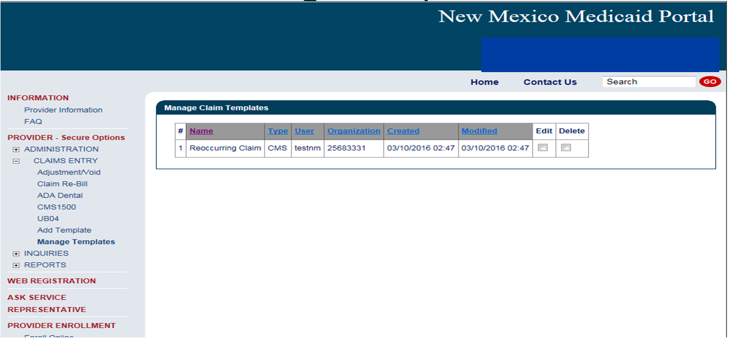

Submitting a Claim on the Web Portal
To submit a claim on the Web Portal, click on the “Claims Entry” option when logged in to your account.
Select the type of claim you want to submit

Slide 20
Submitting a Claim on the Web Portal
For further Instructions on submitting claims on the Web Portal, review the Training Presentations on the Web Portal under “Provider Information” found here: https://nmmedicaid.portal.conduent.com/static/ProviderInformation.htm#TrainingPresentations
These training presentations cover how to bill the following claim types in detail:
CMS-1500
UB-04
ADA Dental

Slide 21
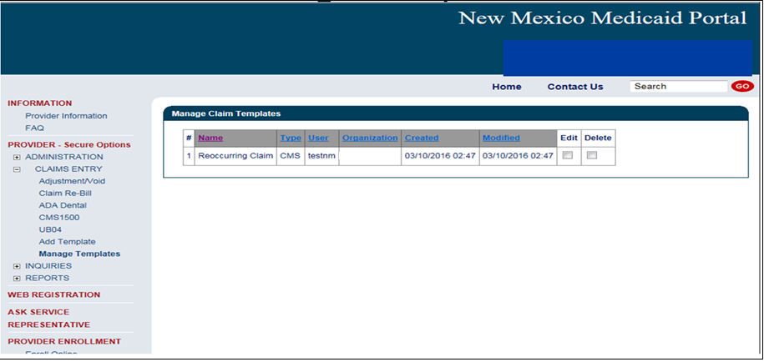
Submitting an Adjustment Request on the Web Portal
To submit an adjustment request, click Adjustment/Void under “Claims Entry” when logged in to your account.

Slide 22
Submitting an Adjustment Request on the Web Portal
For more information on submitting Adjustment Requests via the Medicaid Portal, please refer to the Online Claims Entry Adjustment, Void, and Re-bill training presentation on the Web Portal under “Training Presentations” found here: https://nmmedicaid.portal.conduent.com/static/ProviderInformation.htm#TrainingPresentations
. This presentation covers Adjustment submissions in detail.
* Please note that you can only adjust the claim through the New Mexico Medicaid Web Portal if the claim was originally submitted via the web portal.

Slide 23
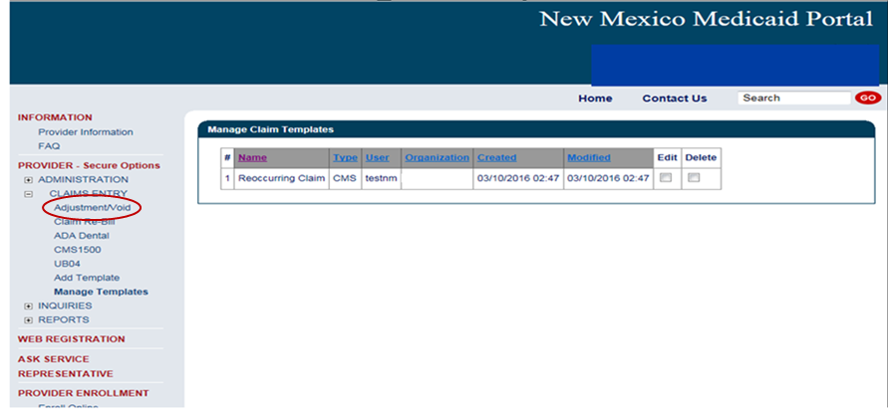
Submitting a Void Request on the Web Portal
To submit a void request, click Adjustment/Void under “Claims Entry” when logged in to your account.

Slide 24
Submitting a Void Request on the Web Portal
For more information on submitting Void Requests via the Medicaid Portal refer to the Online Claims Entry Adjustment, Void, and Re-bill training presentation on the Web Portal under “Training Presentations” found here: https://nmmedicaid.portal.conduent.com/static/ProviderInformation.htm#TrainingPresentations
This presentation covers void submissions in detail.
* Please note that you can only void a claim through the New Mexico Medicaid Web Portal if the original claim was submitted via the web portal.

Slide 25
Submitting a Claim Re-bill on the Web Portal
To re-bill a denied claim, click Claim Re-bill under “Claims Entry” when logged in to your account.

Slide 26
Re-billing a Claim on the Web Portal
For more information on re-billing a denied claim via the Medicaid Portal refer to the Online Claims Entry Adjustment, Void, and Re-bill training presentation on the Web Portal under “Training Presentations” found here: https://nmmedicaid.portal.conduent.com/static/ProviderInformation.htm#TrainingPresentations
This presentation covers claim re-bill submissions in detail.
* Please note that you can only re-bill a claim through the New Mexico Medicaid Web Portal if the original claim was submitted via the web portal.

Slide 27
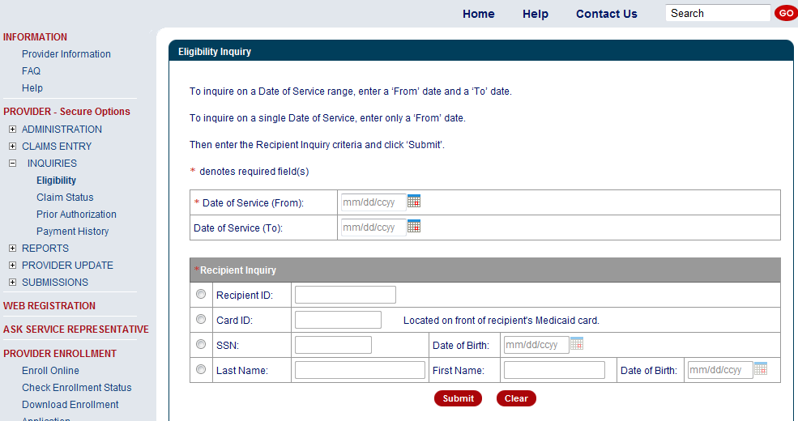
Checking Eligibility on the Web Portal
To check client eligibility, click Eligibility under “Inquiries” when logged in to your account.
Enter the dates you are checking eligibility for.
Please note the web portal can not check future dates of services.
Select the criteria you wish to search the client by and enter the corresponding information and click submit

Slide 28
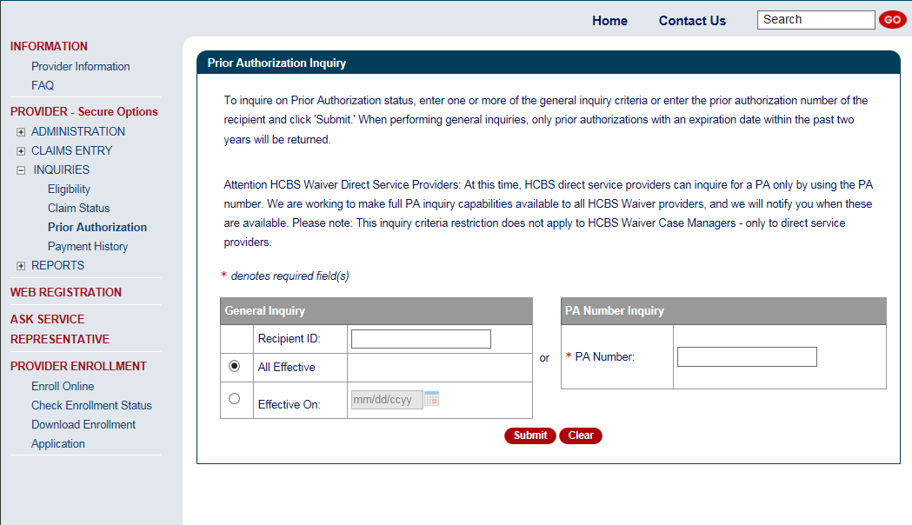
Checking Prior Authorization Status on the Web Portal
You can check the status using the “PA Number Inquiry” if you have a PA number.
If a PA is needed, please contact the Third Party Assessor. Click the following link for more information: https://nmmedicaid.portal.conduent.com/static/ProviderInformation.htm#Third_Party_Assessor
You can use the General Inquiry search if you do not have a PA number.

Slide 29
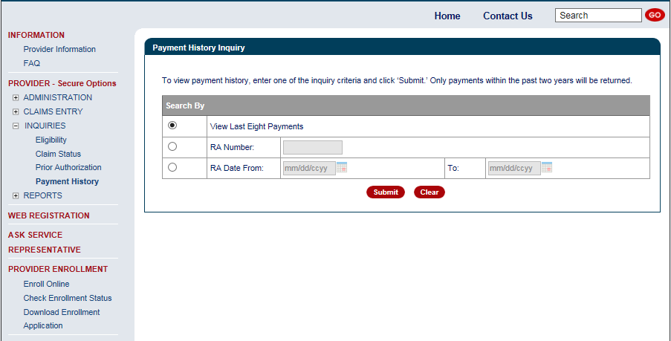
Checking Payment History on the Web Portal
To check payment history, click Payment History under “Inquiries” when logged in to your account.
Select which search inquiry you wish to use and enter the corresponding information.
Please note that this function is to check the Payment History only. This function will not give client information for paid claims nor denial reasons for denied claims. For paid or denied claim information, please check your remittance advice (RA).

Slide 30
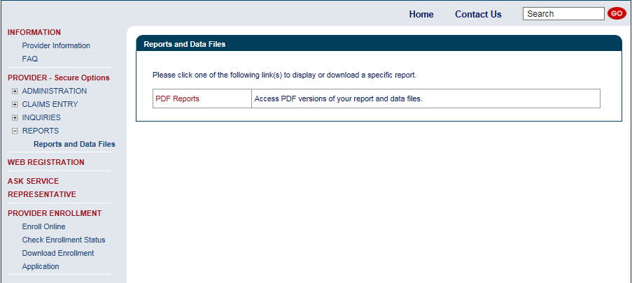
Retrieving Your Remittance Advice on the Web Portal
To retrieve a Remittance Advice (RA), click Reports and Data Files under “Reports” when logged into your account.
Click on PDF Reports

Slide 31
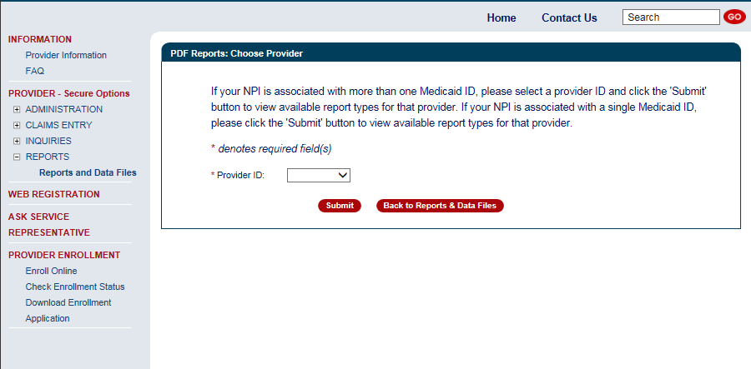
Retrieving Your Remittance Advice on the Web Portal
Use the drop down to select the Provider ID.

Slide 32
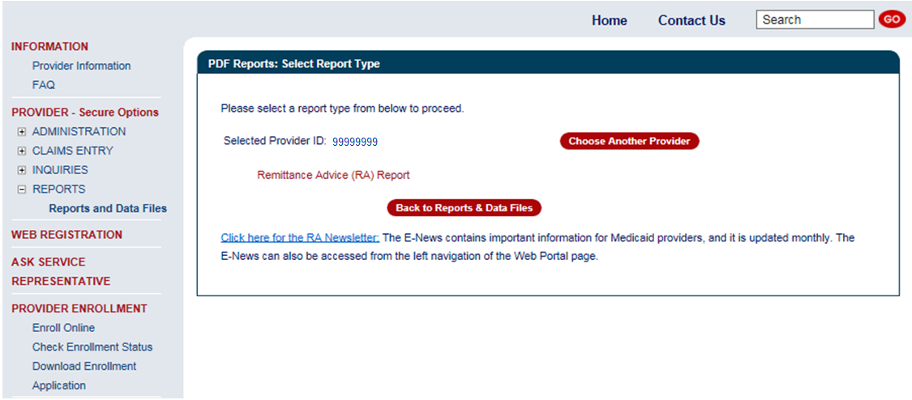
Retrieving Your Remittance Advice on the Web Portal
Click here to bring up a list of RA’s.

Slide 33
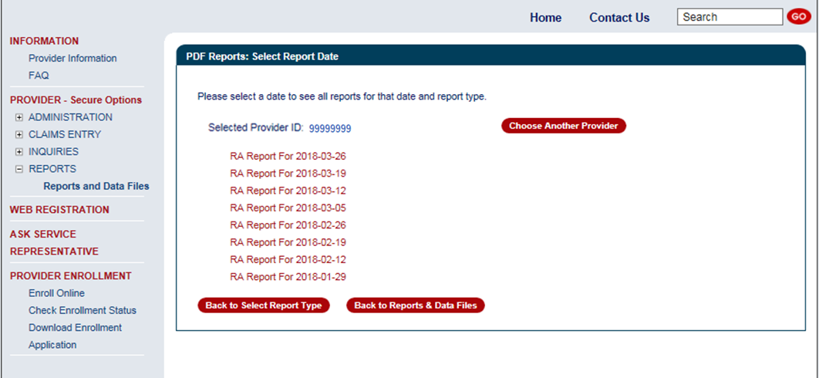
Retrieving Your Remittance Advice on the Web Portal
Click the date of the RA you wish to view.
Please note that the Portal will only store the last eight RA’s on file. If you need an RA that is no longer posted on the web portal, contact the Provider Support mailbox: NMProviderSupport@Conduent.com.

Slide 34
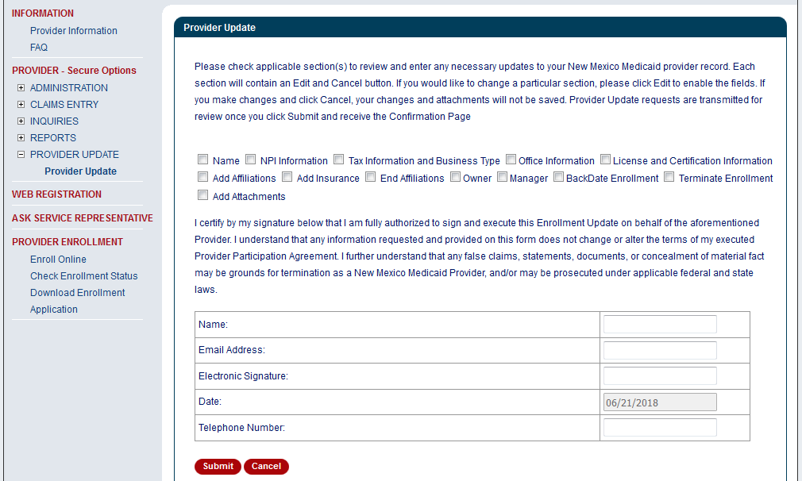
Submitting Provider Updates on the Web Portal
Select the checkbox to expand section(s) and submit update requests to your provider record

Slide 35
New Mexico Medicaid Resources
New Mexico Medicaid Online
      Provider Information
      Provider Login Screen Notices
      Provider E-News Newsletters
Medicaid Provider Relations Call Center
Provider Communication Updates
Provider Field Representative
Provider Webinars
Open Forums and Live Training Sessions
Continued on next page . . .

Slide 36
New Mexico Medicaid Resources Continued
New Mexico Medicaid Portal – https://nmmedicaid.portal.conduent.com/static/index.htm
Claim Inquiries, Eligibility Verification, Electronic Claim Submission, Provider Manuals, E-News
NM Human Services Department – http://www.hsd.state.nm.us/mad/
Supplements, Memos, Provider Billing Packets and Policy
Medical Assistance Division – PE Program Staff – HSD.PEDeterminers@state.nm.us
Assistance with PE Applications, PE Determinations, MAD 070, PE Training, PE Certification
Consolidated Customer Service Center (CCSC) Helpdesk– (800) 299 - 7304.
Claim Status, Eligibility, Prior Authorization, Medicaid Updates
Consolidated Customer Service Center (CCSC) Helpdesk – NM.Providers@state.nm.us
Claim research assistance, general Medicaid inquiries, Provider Enrollment Applications, Forms & Instructions
HIPAA Helpdesk – HIPAA.desknm@state.nm.us
Assistance on NM Web Portal, EDI inquiries, and Online Claim Submission with DDE (Direct Data Entry)
Consolidated Customer Service Center (CCSC) Helpdesk – (800) 283-4465
Eligibility inquiries, Fee-for-Service Replacement Medicaid Identification Card, Enroll or change a Managed Care Organization and Eligibility application status
Medical Assistance Division, Program Rules – http://www.hsd.state.nm.us/providers/rules-nm-administrative-code-.aspx
NMAC for Programs administered by the Medical Assistance Division
Yes New Mexico - https://www.yes.state.nm.us/yesnm/home/index
Apply, check, update, or renew Medical Assistance (Medicaid) benefits

